Slide 1
Data Acquisition and Wrangling
Analysis of Ride Data
By Abhishek jain
15th oct 2024

Slide 2

Introduction
The goal of this project is to be clean and prepare dataset for analysis.
Data used:-
Dataset 1
Dataset 2
Dataset 3

Slide 3
Problem Statement
Outline the challenges faced with the datasets (e.g., missing values, Drop unnecessary columns)

Slide 4
Dataset Overview
Dataset Attributes:
Date
Season
Holyday
Working Day
Weather
Temperature
Windspeed
Casual
Registered
Data Sources:
The datasets were sourced from the NEXTHIKES IT Solution which gives us the internship program and this project gave by the mentor.

Slide 5
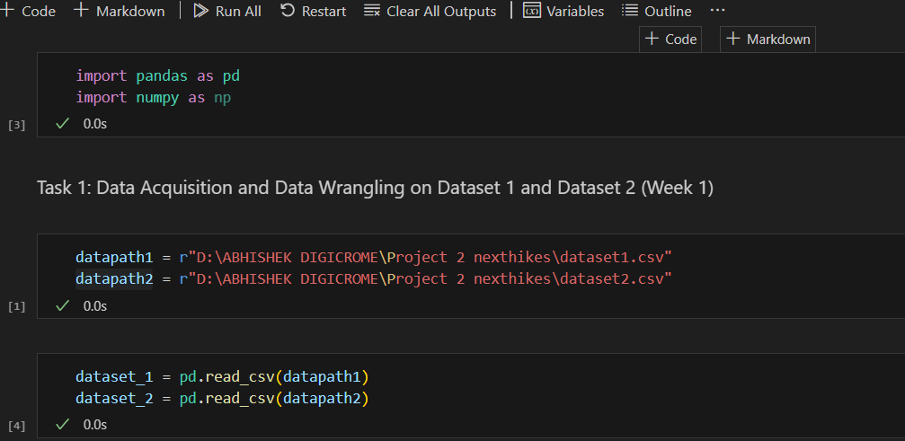
Data Acquisition
Methods Used:
Loading datasets (mention libraries like Pandas).
Numpy

Slide 6

Data Wrangling Techniques
Merge datasets
Identify unique values
Drop unnecessary columns
Check the dimensions of the dataset
Check the datatype of the dataset
Check datatype summary
Treat missing values

Slide 7
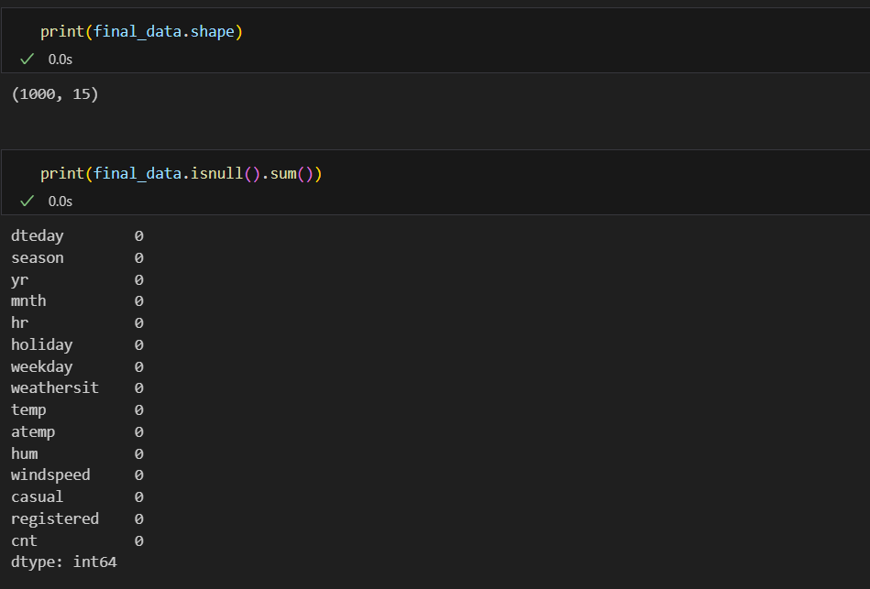
Final Dataset Summary
Shape and Data Types:
Display the shape of the final dataset.
Show a summary of data types.

Slide 8
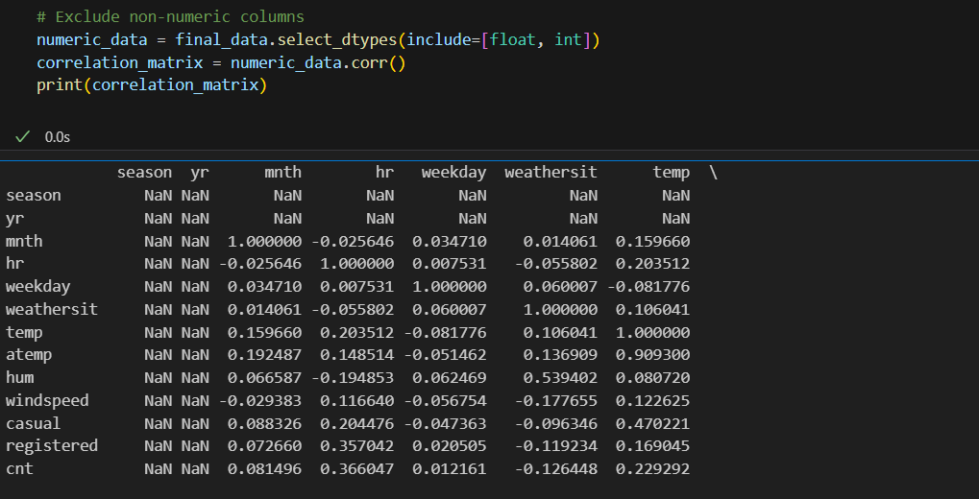
Skewness and Correlation
Findings :
Display skewness values.
Present a correlation matrix

Slide 9
Conclusion
Key Insights:
Summarize findings and what they mean for further analysis.
Next Steps:
Suggest further analyses or modeling to be done

Slide 10


